Slide 1
3D RECONSTRUCTION OF 2D IMAGES
Muhammad Osama Nusrat(21I-2169)

Slide 2
Motivation
The research of 3D reconstruction has always been a difficult goal.
Using 3D reconstruction one can determine any object's 3D profile, as well as knowing the 3D coordinate of any point on the profile.
[1] Agarwal, S., Furukawa, Y., Snavely, N., Simon, I., Curless, B., Seitz, S. M., & Szeliski, R. (2011). Building Rome in a day.Communications of the ACM,54(10), 105-112.

Slide 3
Introduction
Structure from motion is a technique used in computer vision that uses a collection of overlapping 2D images to develop a 3D model of the scene captured by the images.
It is used in many disciplines where 3D information is vital for further processing like autonomous navigation, trajectory tracking, and surface conditioning.
The best thing about this algorithm is that it is applicable on low cost cameras, hence it is an efficient technique for the 3D problems. For our case, we used a single mobile camera since it seemed the most suitable option.
Recently, SFM has been integrated with technologies such as stereo and lasers to produce an absolute reconstruction of the scene, correct to a margin of few millimeters.
The algorithms used for matching keypoints in images were SIFT/SURF.

Slide 4
Literature review
Structure from motion is basically used to predict the geometry of a material.
Multiple images from different camera angles aretaken of same object and then we match the features of 2 images and reconstruct the 3d model of the object.
First of all take multiple images of your desired object from different camera positions
Then we take one image at a time and undistort that image.
The image taken by first camera position is then taken as a refernce and we set its coordinate as (0,0,0).
After that the image background is changed from rgb to gray because SFM works at gray scale images.
In next step SFM detect key points in our image. Key points are also called features of an image Region of interest is found in our image and we crop it.
From key point we can make a feature vector. Feature vector are used to find the matching points in the two images.

Slide 5
Same step is repeated from second image which is taken from different camera position. SFM detects key points from that image also.
Note both images are of same object. The difference is that they are taken at different camera positions Now these key features of both images will help to generate projection matrix.
Camera has 2 parameters intrinsic and extrinsic parameters. In intrinsic parameter include focal length and image size and extrinsic parameters include rotation and translation.
When intrinsic and extrinsic matrix are combined we get projection matrix. With the help of projection matrix we can find a 3d points of an image.
At this stage we have found matching points in two images and we know position of camera 1 which is origin Now we need to find position of camera 2. .
After finding position of camera 2 we can find 3d points. Bundle adjustment is used to reduce error incase our 3d points are not accurate.

Slide 6
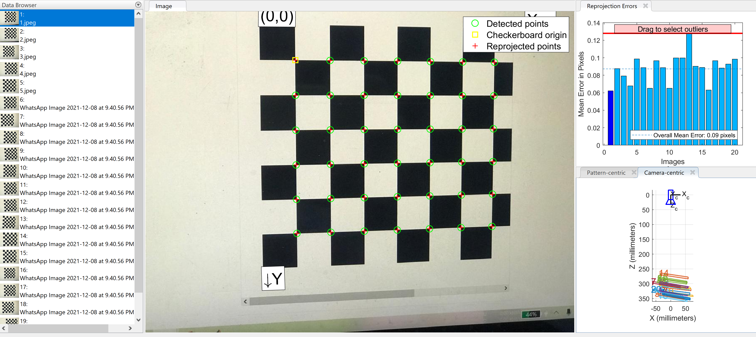
METHODOLOGY
CAMERA CALIBRATION

Slide 7
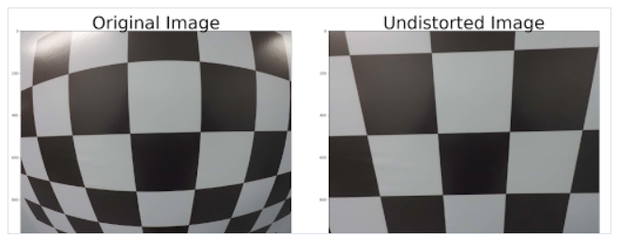

Slide 8
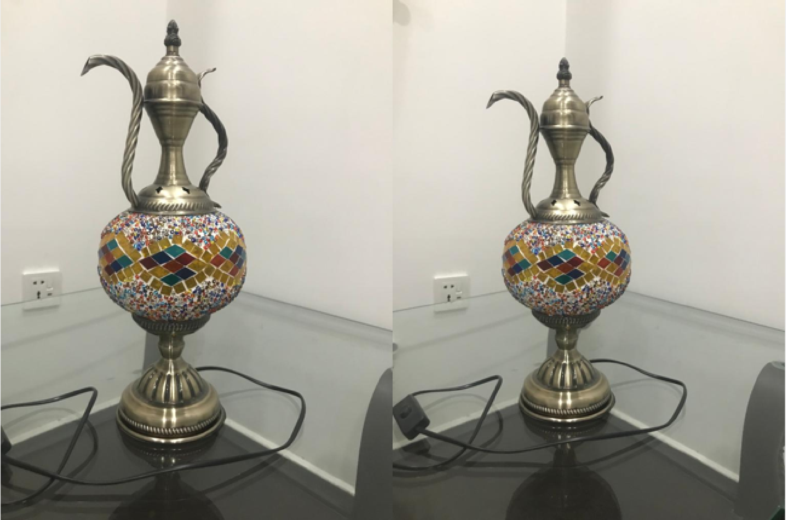
INPUT IMAGE

Slide 9
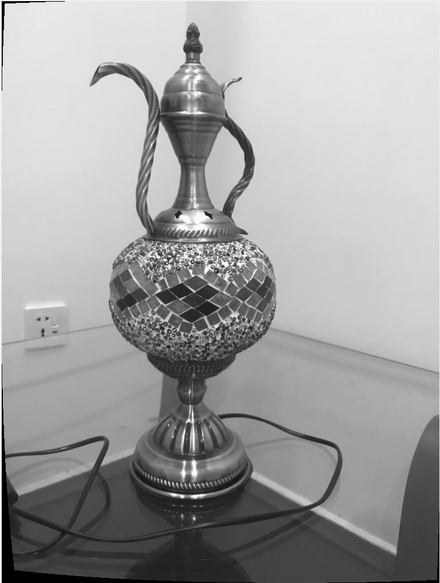
GRAY SCALE IMAGE

Slide 10
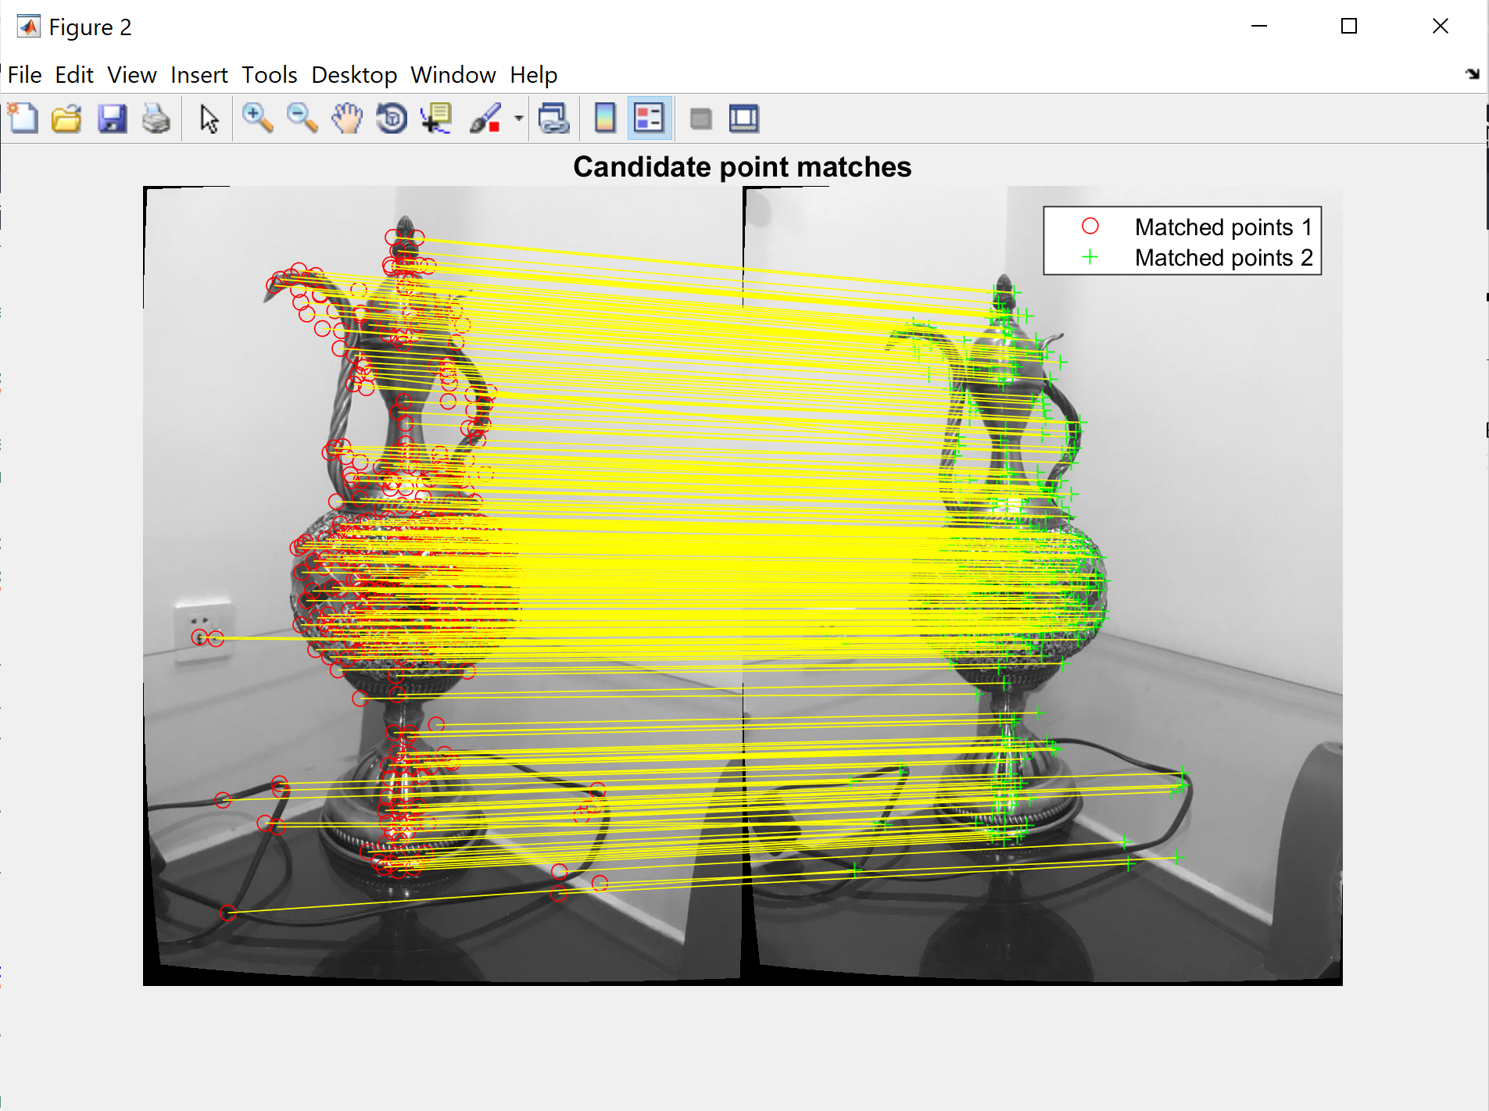
FEATURE MATCHING

Slide 11
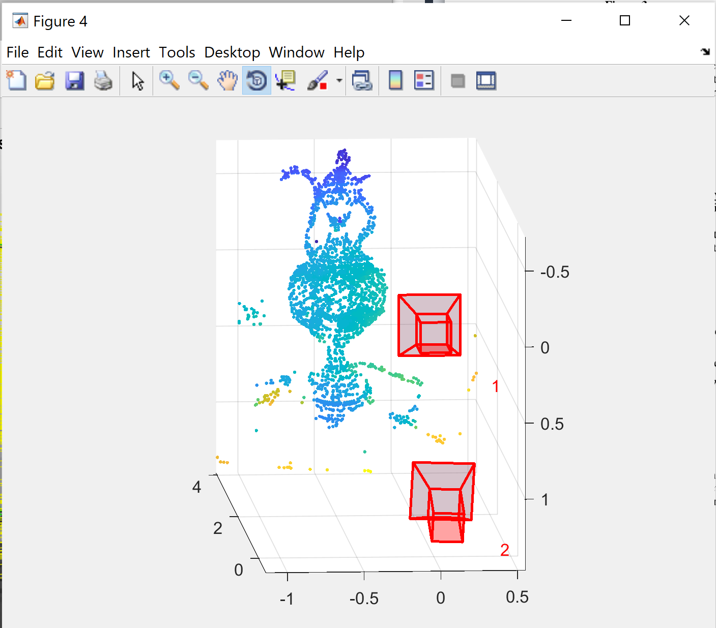
3D RECONSTRUUCTION

Slide 12
References
[1] Agarwal, S., Furukawa, Y., Snavely, N., Simon, I., Curless, B., Seitz, S. M., & Szeliski, R. (2011). Building Rome in day. Communications of the ACM,54(10), 105-112.

